Slide 1
INTERNSHIP REPORT PRESENTATION
WEB DEVELOPMENT
THIRANEX
Student
Shreya Singh
Roll No. 2410031406
Internship
31 July 2026 – 30 August 2026
Remote / Project-Based
Thiranex • Web Development Internship • Shreya Singh | 01

Slide 2
ABOUT THE STUDENT
2
Candidate profile and internship details
Name
Shreya Singh
Roll Number
2410031406
Programme
B.Tech – Computer Science & Engineering
Institute
IILM University, Greater Noida, U.P.
Internship Domain
Web Development
Duration
31 July – 30 August 2026
Work Mode
Remote / Project-Based
Internship Status
100% completed
Intern ID
THX-JUL3126-494
Thiranex • Web Development Internship • Shreya Singh | 02

Slide 3
ABOUT THIRANEX
3
Skill Development & Future Tech
Organization
Thiranex — Skill Development & Future Tech
Internship Role
Intern – Web Development
Internship Model
Remote / Project-Based
Practical Exposure
Hands-on web development tasks under industry mentorship
Completion
Certificate of Achievement issued for successful completion
Thiranex • Web Development Internship • Shreya Singh | 03

Slide 4
PROBLEM STATEMENT
4
Bridging web-development theory with practical implementation
Challenge
Students may learn HTML, CSS and JavaScript individually, but practical development requires combining them into accessible, responsive and interactive applications. The internship addressed this gap through project-based tasks covering semantic HTML, responsive CSS, JavaScript state management, REST APIs and deployment architecture.
HTML5
Semantic structure
CSS3
Responsive UI
JavaScript
Logic & state
REST API
Async data
Deployment
Full delivery
Thiranex • Web Development Internship • Shreya Singh | 04

Slide 5
PROJECT OBJECTIVES
5
What the internship set out to achieve
Semantic HTML
Build accessible, SEO-friendly page structures.
Advanced CSS
Use Grid, Flexbox, variables and responsive media queries.
JavaScript
Implement CRUD, DOM manipulation, events and local storage.
REST APIs
Fetch and process JSON asynchronously with error handling.
Deployment
Understand modular architecture, optimization and live deployment.
Portfolio / Capstone
Apply the learned concepts in complete web projects.
Thiranex • Web Development Internship • Shreya Singh | 05

Slide 6
TECHNOLOGIES & TOOLS
6
Toolkit used across the internship tasks
HTML5
Semantic structure & accessibility
CSS3
Responsive layouts & styling
JavaScript
DOM, state & event handling
REST APIs
Real-time JSON data
Local Storage
Client-side persistence
Git / GitHub
Source control & project sharing
VS Code
Development environment
Deployment
Vercel / Netlify / Render
Thiranex • Web Development Internship • Shreya Singh | 06

Slide 7
METHODOLOGY
7
Five completed project-based internship tasks
01
HTML5 Semantic Structure & Accessibility
07 Aug 2026
02
Advanced CSS3 & Responsive Architecture
14 Aug 2026
03
JavaScript Logic & State Management
21 Aug 2026
04
Asynchronous JavaScript & RESTful APIs
28 Aug 2026
05
Full-Stack Deployment & Project Architecture
30 Aug 2026
Thiranex • Web Development Internship • Shreya Singh | 07

Slide 8
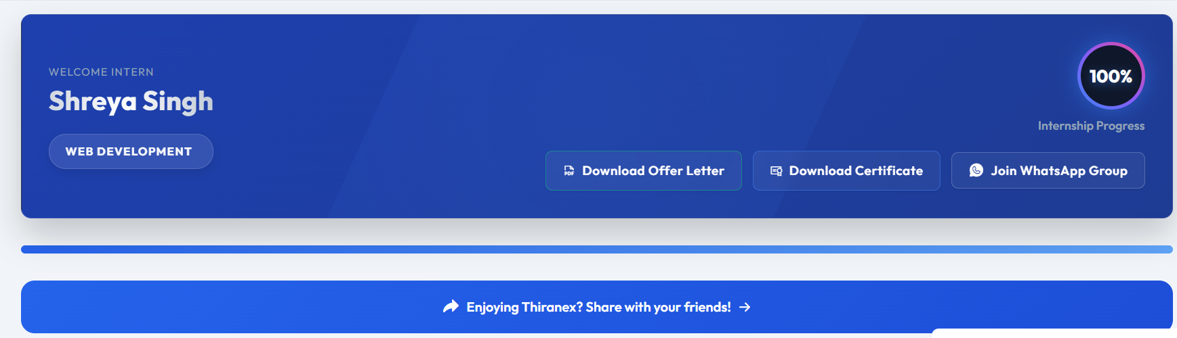
PROJECT ARCHITECTURE
8
From semantic structure to a dynamic web application
Presentation
HTML5 + CSS3 responsive UI
Logic
JavaScript DOM + state management
Data
REST API + asynchronous fetch
Persistence
localStorage for client-side data
Deployment
Optimized modular application
Weather Dashboard — REST API task
Thiranex • Web Development Internship • Shreya Singh | 08

Slide 9
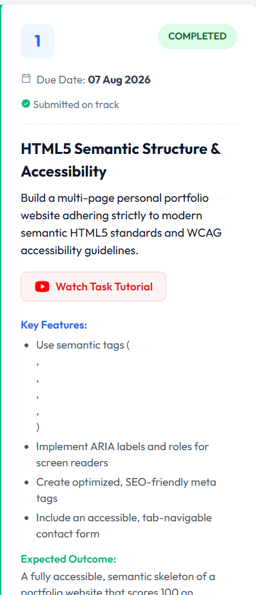
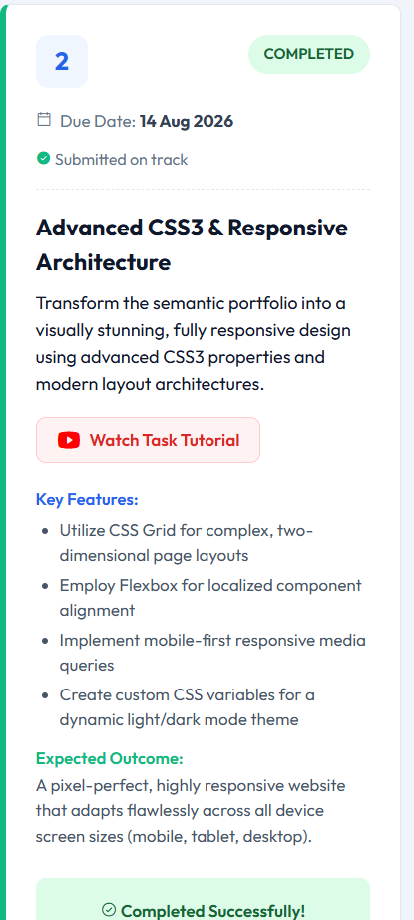
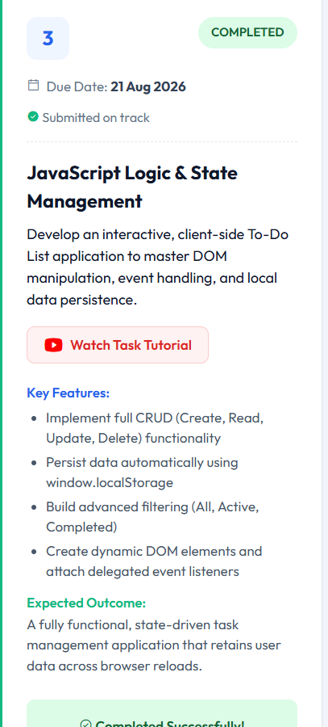
HANDS-ON TASKS
9
Selected evidence from completed internship tasks
Task 1 — Semantic HTML
Task 2 — Responsive CSS
Task 3 — JavaScript State
Thiranex • Web Development Internship • Shreya Singh | 09

Slide 10
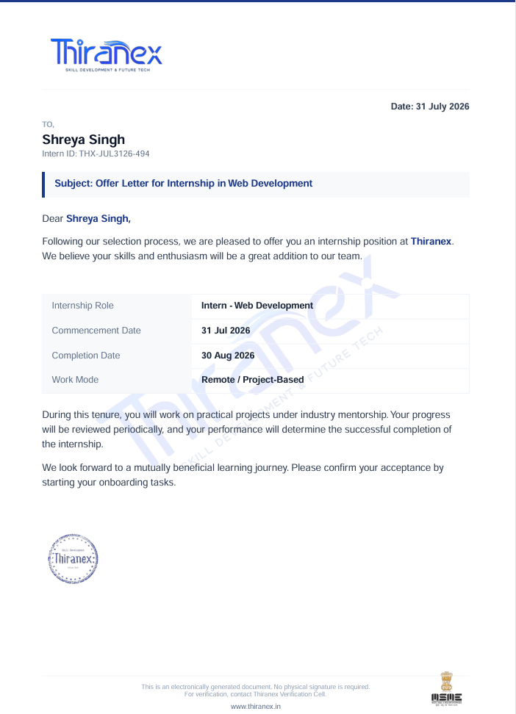
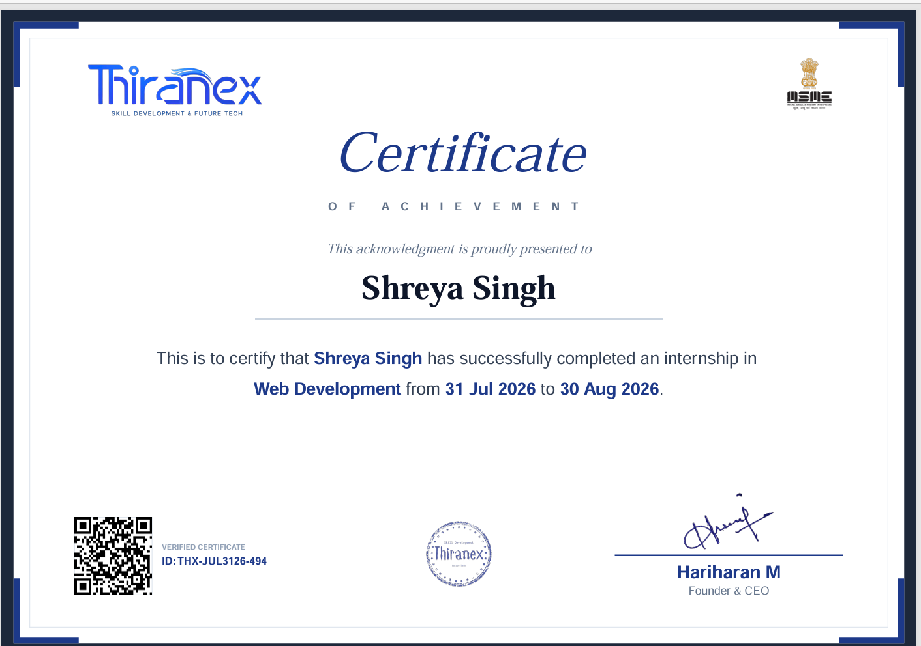
CERTIFICATION & INTERNSHIP PROOF
10
Official Thiranex documents
Thiranex • Web Development Internship • Shreya Singh | 10

Slide 11
EXPECTED OUTCOMES & SKILLS GAINED
11
Practical capabilities developed during the internship
01
Build semantic and accessible HTML5 pages.
05
Consume REST APIs using Fetch API and async/await.
02
Design responsive interfaces using CSS Grid, Flexbox and media queries.
06
Handle network errors and dynamic JSON data.
03
Develop interactive client-side applications using JavaScript.
07
Understand modular web application architecture and deployment.
04
Use CRUD operations, DOM manipulation and localStorage.
08
Apply the complete workflow through project-based tasks.
Thiranex • Web Development Internship • Shreya Singh | 11

Slide 12
THANK YOU
Shreya Singh
Web Development Intern • Thiranex
IILM University, Greater Noida

